Slide 1
text to features

Slide 2
text to features
One-hot encoding (OHE)
CountVectorizer
TF-IDF
word embedding tools.
Word2vec
fastText
GloVe

Slide 3
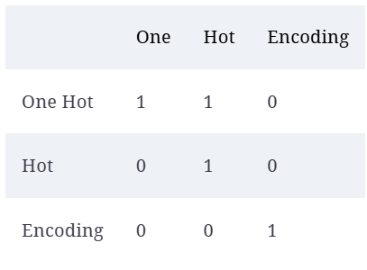
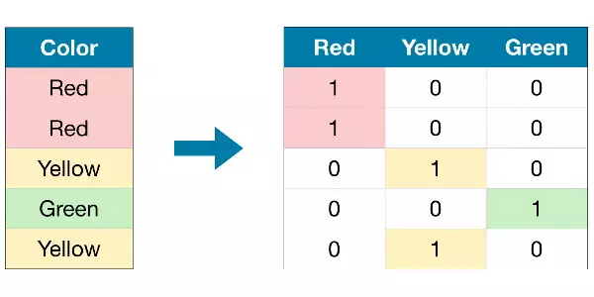
One-hot encoding (OHE)

Slide 4
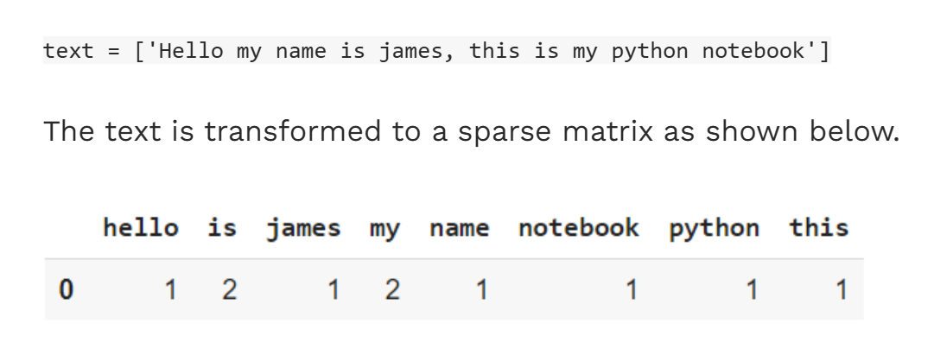
CountVectorizer
We have 8 unique words in the text and hence 8 different columns each representing a unique word in the matrix.
By default, Countvectorizer converts the text to lowercase and uses word-level tokenization.

Slide 5
class sklearn.feature_extraction.text.CountVectorizer
(*,
input='content',
encoding='utf-8',
decode_error='strict',
strip_accents=None,
lowercase=True,
preprocessor=None,
tokenizer=None,
stop_words=None,
token_pattern='(?u)\\b\\w\\w+\\b',
ngram_range=(1, 1),
analyzer='word',
max_df=1.0,
min_df=1,
max_features=None,
vocabulary=None,
binary=False,
dtype=<class 'numpy.int64'>)
https://scikit-learn.org/stable/modules/generated/sklearn.feature_extraction.text.CountVectorizer.html

Slide 6
HashingVectorizer
Convert a collection of text documents to a matrix of token counts.
TfidfVectorizer
Convert a collection of raw documents to a matrix of TF-IDF features.

Slide 7
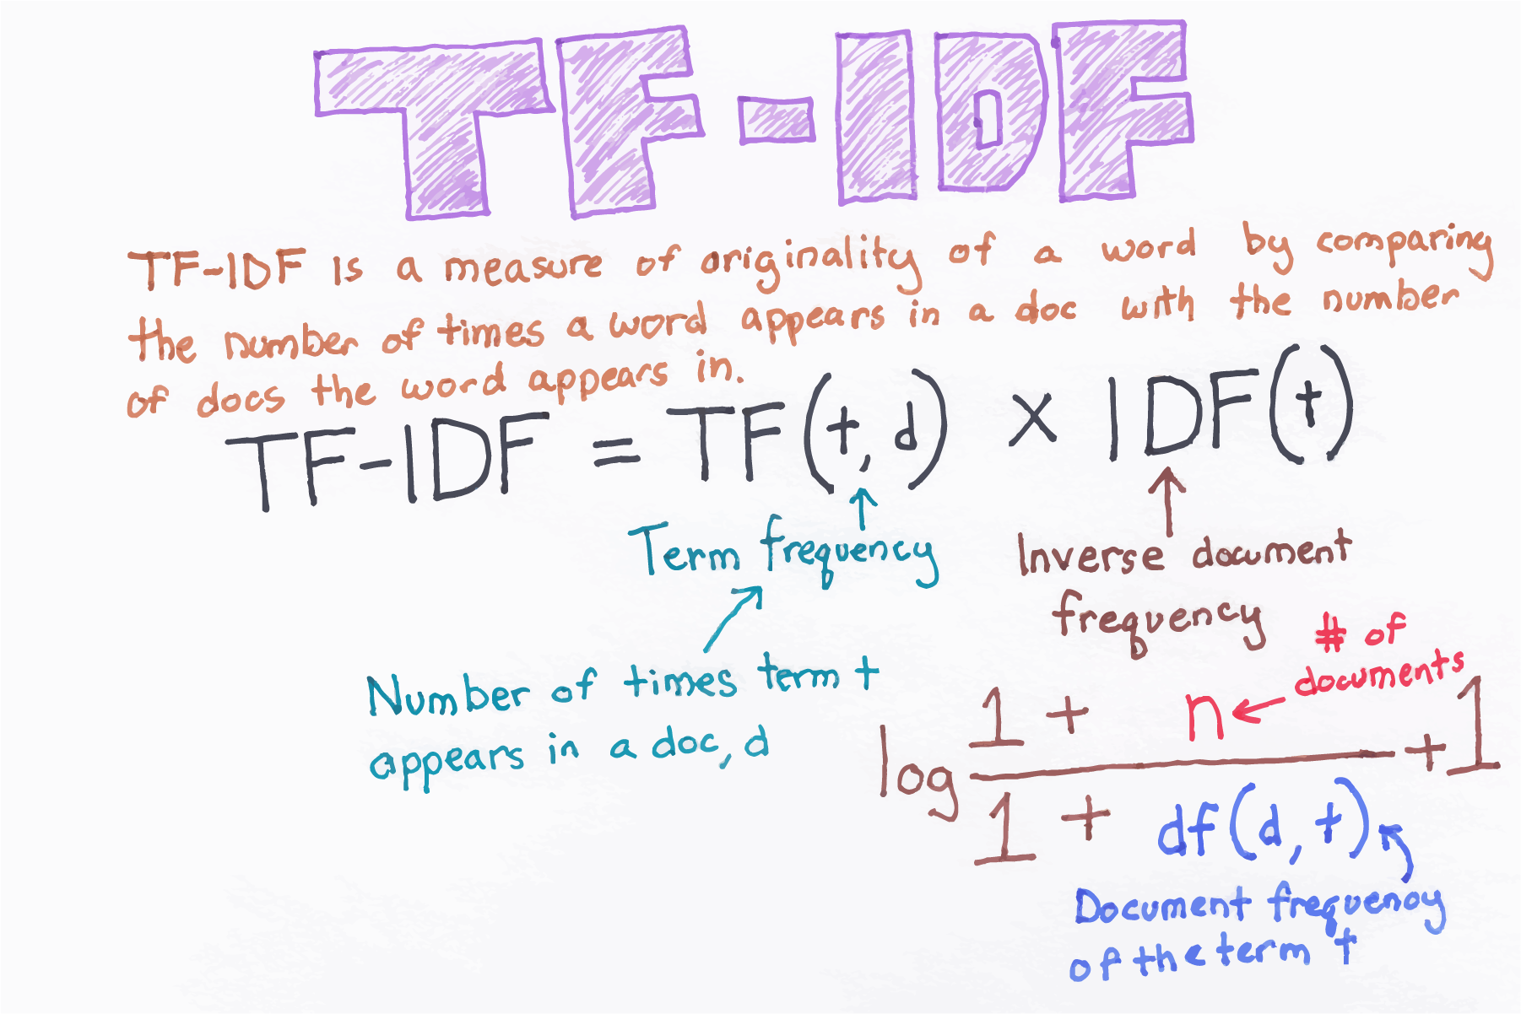

Slide 8
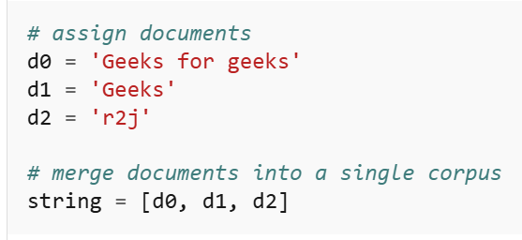
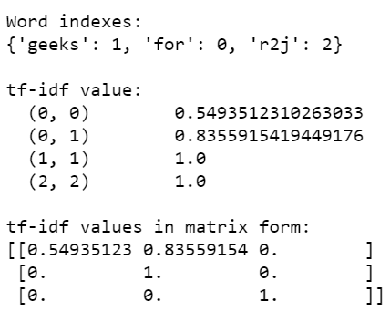
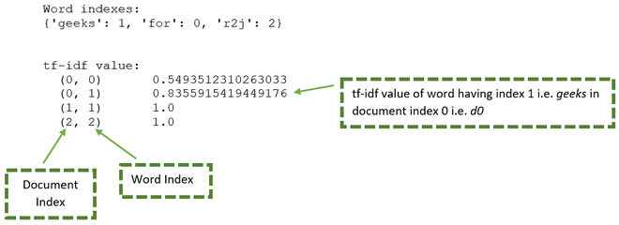

Slide 9
class sklearn.feature_extraction.text.TfidfVectorizer
(*,
input='content',
encoding='utf-8',
decode_error='strict',
strip_accents=None,
lowercase=True,
preprocessor=None,
tokenizer=None,
analyzer='word',
stop_words=None,
token_pattern='(?u)\\b\\w\\w+\\b',
ngram_range=(1, 1),
max_df=1.0,
min_df=1,
max_features=None,
vocabulary=None,
binary=False,
dtype=<class 'numpy.float64'>,
norm='l2',
use_idf=True,
smooth_idf=True,
sublinear_tf=False)

Slide 10
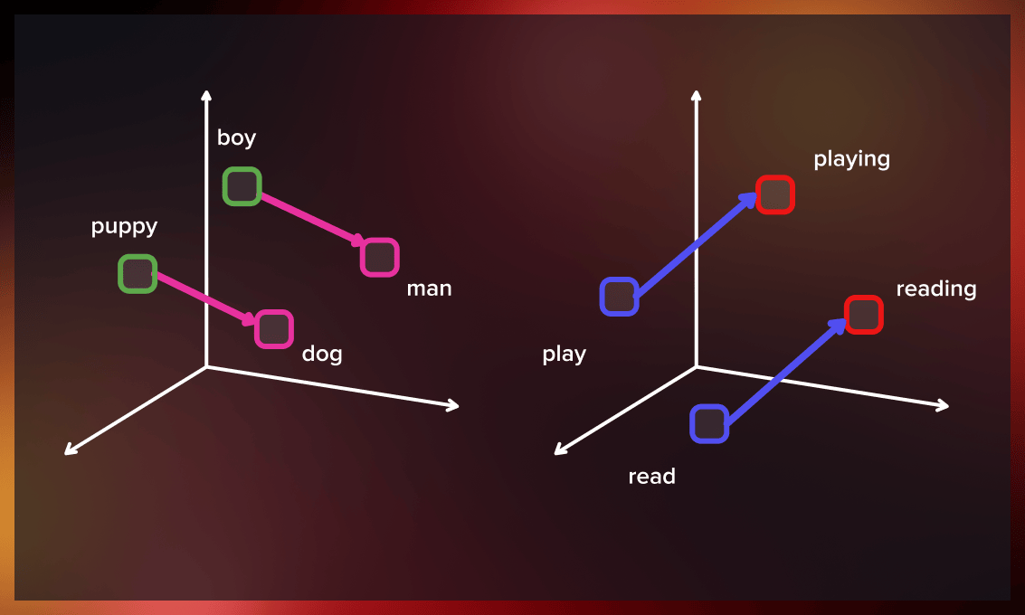
WordVector

